Slide 1
Simulating and Visualizing Quantum Circuits
Michael McGuffin, Professor
École de Technologie Supérieure (ETS),
Created 2023-11-24; updated 2023-12-06

Slide 2
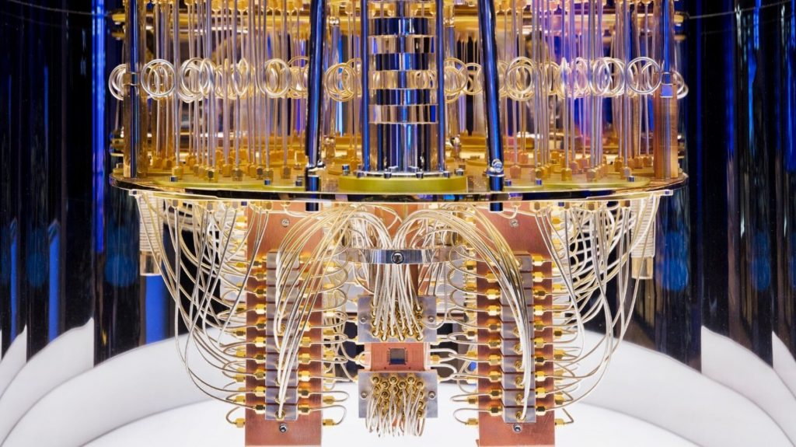
Quantum Computers: IBM
Notes:
Many possible physical implementations of qubits:
Photo polarization
Particle spin (ions, electrons)
Superconducting current loops
Current chips suffer from noise and decoherence

Slide 3
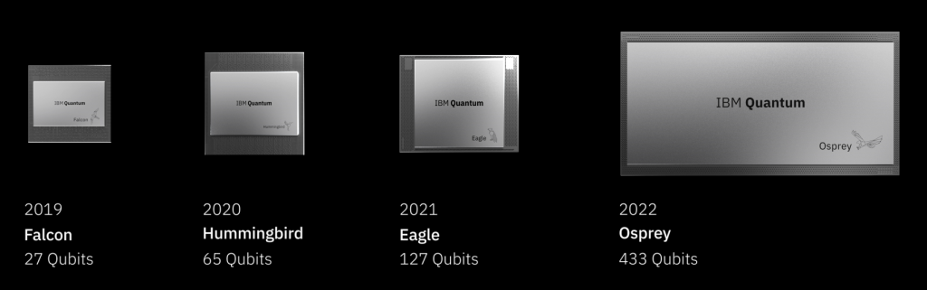
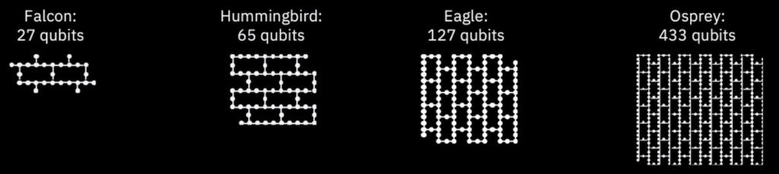
Quantum Computers: IBM

Slide 4
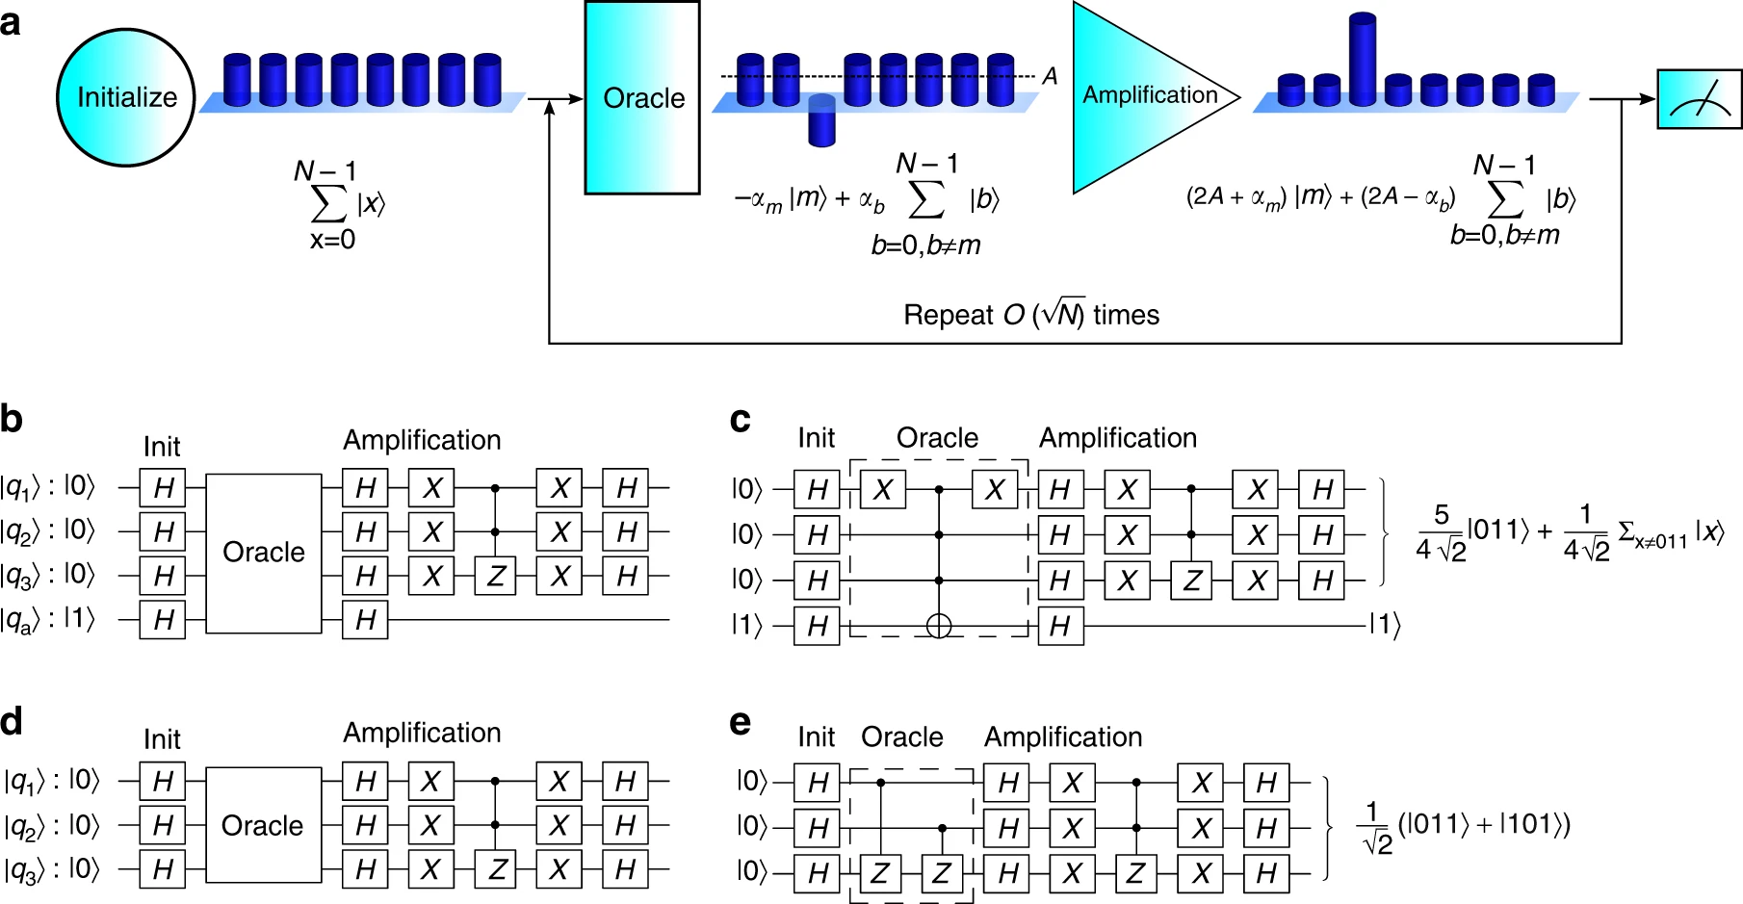
Grover’s algorithm: search over N items in O(N^{1/2}) time instead of O(N) time, yielding a quadratic speedup
https://www.nature.com/articles/s41467-017-01904-7

Slide 5
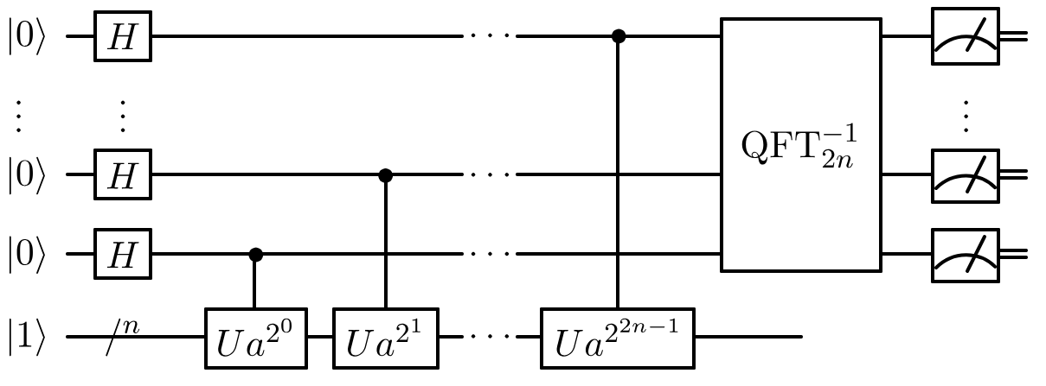
Shor’s algorithm: factors N in time that is polynomial in log N instead of time that is sub-exponential in log N , yielding a superpolynomial speedup
https://en.wikipedia.org/wiki/Shor%27s_algorithm

Slide 6
Qubits can be implemented using photon polarization, particle spin, superconducting current loops…
Qubits can store 0 and 1 in superposition. Measuring the state of a qubit causes it to collapse to 0 or 1. Qubits can also be entangled (i.e., there is a correlation between their measured values).
Quantum circuits and quantum logic gates are an abstraction layer on top of physical qubits
We hide the details of the physical qubits
We typically assume no noise, no decoherence, and assume the qubits are fully interconnected, and assume all qubit logic gates are available to us. In reality, there may be a compiler or translation stage that substitutes gates, adds swaps, optimizes for noise, etc.
The ‘wires’ (horizontal lines) are metaphorical; they show the sequence of operations on each qubit, with time advancing left-to-right. They are not physical wires.
The circuit is typically executed many times, allowing us to measure probabilities of 0 and 1
All quantum circuits can be simulated on a classical computer
Simulating an N-qubit circuit with a classical computer requires exponential (O(2^{N})) time and space, but this does not necessarily mean that a quantum algorithm gives us an exponential speedup over the best classical algorithm. The speedup from a quantum computer depends on the details of the algorithm.

Slide 7
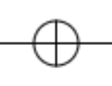
NOT gate (also called X gate)
a | NOT a
0 | 1
1 | 0
a
NOT a

Slide 8
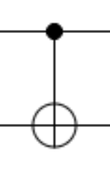
CNOT “controlled-not” gate (similar to XOR gate)
a | b | a⊕b
0 | 0 | 0
0 | 1 | 1
1 | 0 | 1
1 | 1 | 0
a
a
b
a ⊕ b
It seems like the second qubit has no causal effect on the first qubit, that the direction of causality is from first to second qubit. However, as we will see, with superposition and entanglement, this gate does strange things.

Slide 9
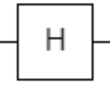
Hadamard gate: one of many gates that create superposition
a | H a
0 | 0 and 1
1 | 0 and 1
a
H a

Slide 10
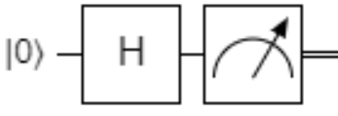
Measurement of a qubit in superposition can result in 0 or 1
Measured output is sometimes 0, sometimes 1.
If we execute the circuit and measure many times, we find the probabilities of 0 and 1 are close to 50%.
Superposition
of 0 and 1

Slide 11
Uncorrelated qubits
Measured output is sometimes 00, sometimes 01, sometimes 10, sometimes 11, each with 25% probability.
Superposition
of 0 and 1
Superposition
of 0 and 1

Slide 12
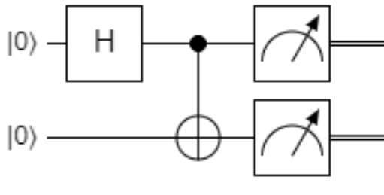
Circuit that entangles two qubits
Measured output is sometimes 00, sometimes 11,
never 01 nor 10.
This correlation means the qubits were entangled.
Superposition
of 0 and 1
Superposition
of 0 and 1

Slide 13
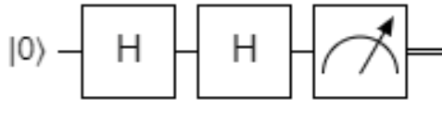
Hadamard is its own inverse. H² = I
Measured output is always 0.
We can say that the two superposed states destructively interfere in the second H gate.
Superposition
of 0 and 1

Slide 14
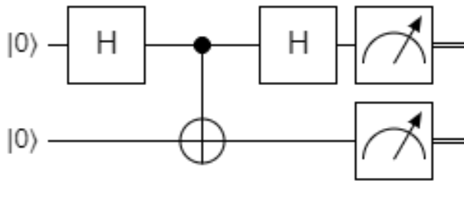
The control bit does not just “read” !!
Measured output can be 00, 01, 10, or 11, each with 25% probability!
So the second H gate no longer has the same effect as previously.
Explanation by Maria Violaris: https://www.youtube.com/watch?v=CI41yWg38Oo

Slide 15
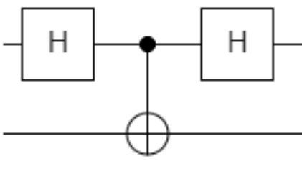
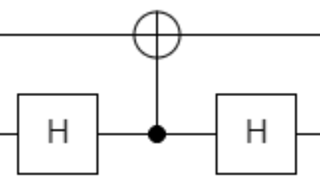
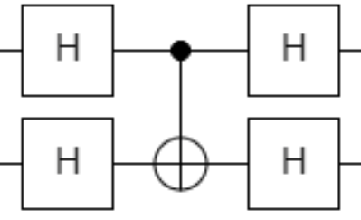
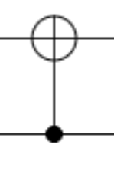
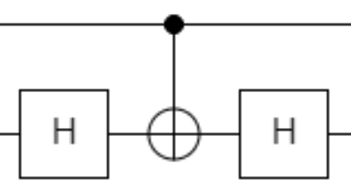
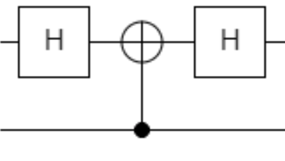
There are equivalent sets of gates. The three equations below are all equivalent to each other (we can see this by adding more H gates and canceling gates when possible). These equivalences also seem to reverse the direction of causality in the CNOT gate!
=
=
=
Notes:
cnot = CMatrix.gate4x4cnot;
swap = CMatrix.wireSwap(0,1,2);
hi = CMatrix.tensor(CMatrix.gate2x2hadamard,CMatrix.gate2x2identity);
ih = CMatrix.tensor(CMatrix.gate2x2identity,CMatrix.gate2x2hadamard);
hh = CMatrix.tensor(CMatrix.gate2x2hadamard,CMatrix.gate2x2hadamard);
m1 = CMatrix.naryMult([hh,cnot,hh]);
m12 = CMatrix.naryMult([swap,cnot,swap]);
console.log(StringUtil.concatenateMultilineStrings(m1.toString(),",",m12.toString()));
m2 = CMatrix.naryMult([ih,cnot,ih]);
m22 = CMatrix.naryMult([hi,swap,cnot,swap,hi]);
m23 = CMatrix.naryMult([swap,ih,cnot,ih,swap]);
m24 = CMatrix.naryMult([hi,m1,hi]);
delta2 = CMatrix.diff(m2,m22);
delta3 = CMatrix.diff(m2,m23);
delta4 = CMatrix.diff(m2,m24);
console.log(StringUtil.concatenateMultilineStrings(m2.toString(),",",m22.toString(),",",m23.toString(),",",m24.toString()));
console.log(StringUtil.concatenateMultilineStrings(delta2.toString(),",",delta3.toString(),",",delta4.toString()));
m3 = CMatrix.naryMult([hi,cnot,hi]);
m32 = CMatrix.naryMult([ih,swap,cnot,swap,ih]);
m33 = CMatrix.naryMult([swap,hi,cnot,hi,swap]);
m34 = CMatrix.naryMult([ih,m1,ih]);
delta2 = CMatrix.diff(m3,m32);
delta3 = CMatrix.diff(m3,m33);
delta4 = CMatrix.diff(m3,m34);
console.log(StringUtil.concatenateMultilineStrings(m3.toString(),",",m32.toString(),",",m33.toString(),",",m34.toString()));
console.log(StringUtil.concatenateMultilineStrings(delta2.toString(),",",delta3.toString(),",",delta4.toString()));

Slide 16
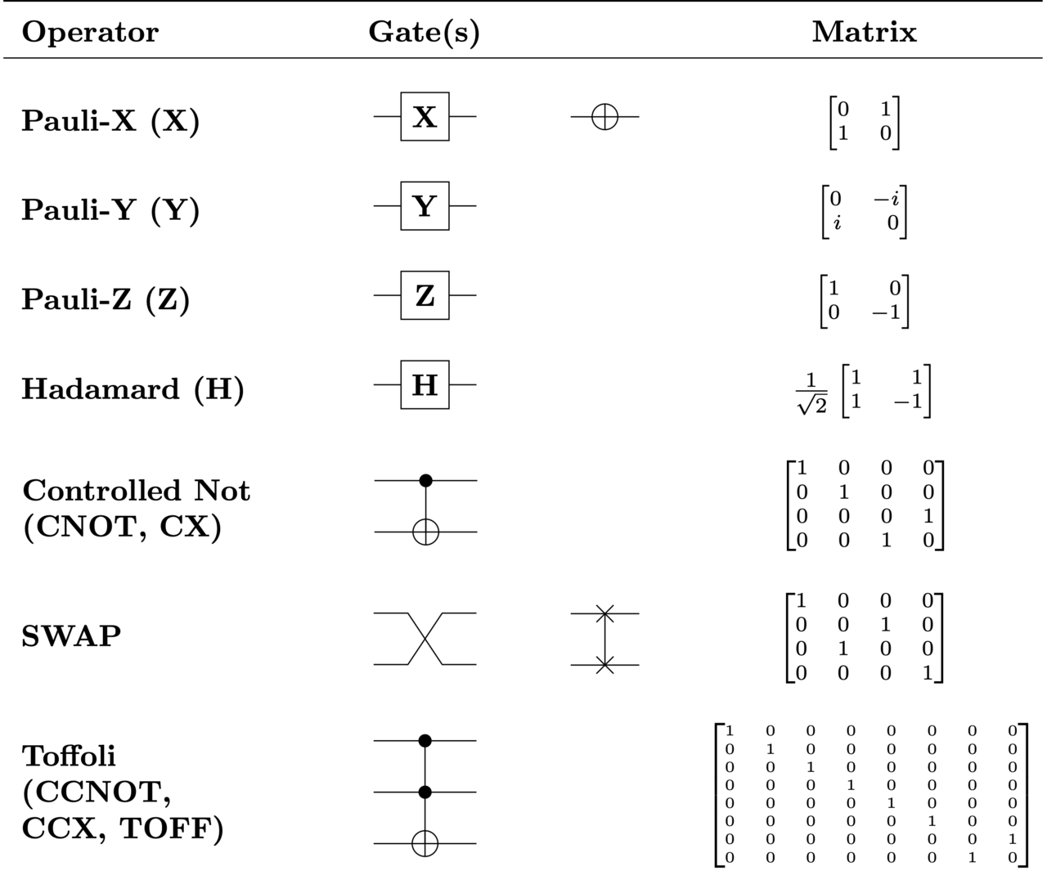
Each gate can be described with a matrix
Table adapted from https://en.wikipedia.org/wiki/Quantum_logic_gate
Notes:
Note that my software uses a different ordering of states:
console.log(CMatrix.gate4x4cnot.toString());
outputs:
[1,_,_,_]
[_,_,_,1]
[_,_,1,_]
[_,1,_,_]

Slide 17
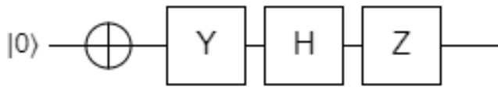
The processing of qubits can be described with matrix multiplications
output
amplitude for 0
amplitude for 0
amplitude for 1
amplitude for 1
$$\left[\begin{matrix}−0.707i \\ 0.707i\end{matrix}\right]=\left[\begin{matrix}1 & 0 \\ 0 & −1\end{matrix}\right]\left[\begin{matrix}0.707 & 0.707 \\ 0.707 & −0.707\end{matrix}\right]\left[\begin{matrix}0 & −i \\ i & 0\end{matrix}\right]\left[\begin{matrix}0 & 1 \\ 1 & 0\end{matrix}\right]\left[\begin{matrix}1 \\ 0\end{matrix}\right]$$
output state vector
input state vector

Slide 18
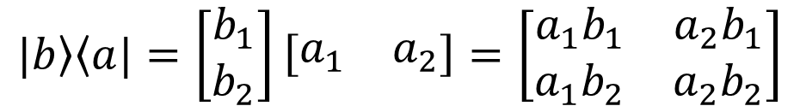
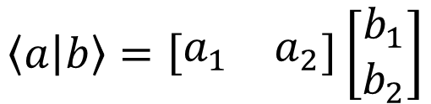
Bra and ket notation
<ψ| is read as “bra psi”, and means the state psi as a row vector
|ψ> is “ket psi”, the state psi as a column vector
<ψ| and |ψ> are the conjugate transpose of each other (their imaginary parts have opposite signs), i.e., <ψ| = |ψ>* or <ψ| = |ψ>†
<a|b> means the dot product of the row vector a with the column vector b, for example:
|b><a| means the matrix product resulting from column vector b multiplied by row vector a, for example:
$$\left\langle a | b\right\rangle =\left[\begin{matrix}a_{1} & a_{2}\end{matrix}\right]\left[\begin{matrix}b_{1} \\ b_{2}\end{matrix}\right]$$
$$|\left.b\right\rangle \left\langle a|\right.=\left[\begin{matrix}b_{1} \\ b_{2}\end{matrix}\right]\left[\begin{matrix}a_{1} & a_{2}\end{matrix}\right]=\left[\begin{matrix}a_{1}b_{1} & a_{2}b_{1} \\ a_{1}b_{2} & a_{2}b_{2}\end{matrix}\right]$$

Slide 19
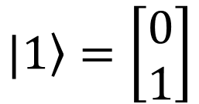
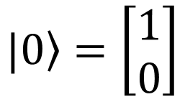
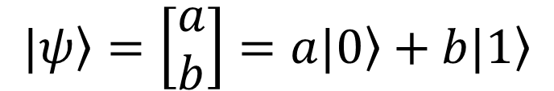
In a single qubit circuit, the state vector is a 2-element column vector containing complex numbers. Each complex number is an amplitude
$$\left.|0\right\rangle =\left[\begin{matrix}1 \\ 0\end{matrix}\right]$$
$$\left.|1\right\rangle =\left[\begin{matrix}0 \\ 1\end{matrix}\right]$$
amplitude for 0
amplitude for 1
amplitudes (complex numbers)
state vector
$$\left.|ψ\right\rangle =\left[\begin{matrix}a \\ b\end{matrix}\right]=a\left.|0\right\rangle +b\left.|1\right\rangle$$
base state vectors

Slide 20
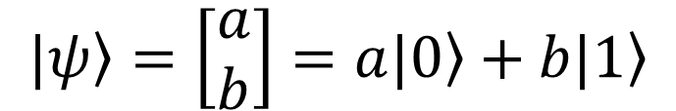
We might think that |ψ> = a |0> + b |1> has 4 degrees of freedom, but …
The probability of measuring a particular base state is given by the squared magnitude of the amplitude
Probability of measuring 0 is |a|²
Probability of measuring 1 is |b|²
Constraint: |a|²+|b|² = 1 (this removes one degree of freedom)
We can also multiply the amplitudes by some number e^{iG} to apply a global phase shift of angle G around the complex plane. This global phase shift has no physical meaning and cannot be measured. This removes another degree of freedom from the amplitudes. Sometimes we choose G to make the first amplitude a positive real number, so we can write |ψ> = α |0> + e^{i φ} (1-α²)^{1/2} |1> where α is positive real. This makes the two degrees of freedom, α and φ, more apparent.
amplitudes
state vector
$$\left.|ψ\right\rangle =\left[\begin{matrix}a \\ b\end{matrix}\right]=a\left.|0\right\rangle +b\left.|1\right\rangle$$
base state vectors
Notes:
https://physics.stackexchange.com/questions/312532/is-there-a-way-to-represent-a-3-qubit-system-using-3-bloch-spheres

Slide 21
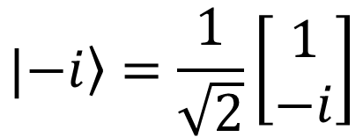
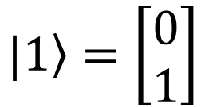
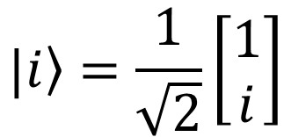
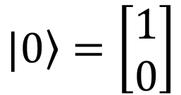
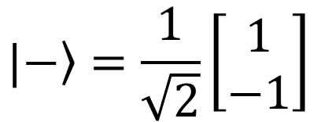
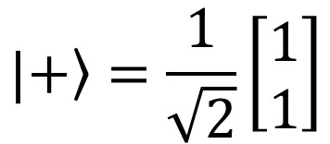
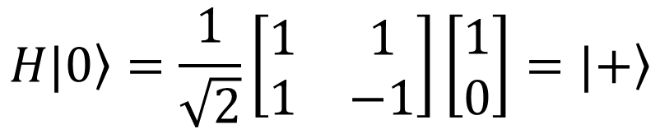
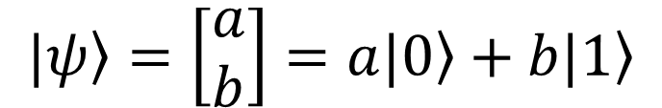
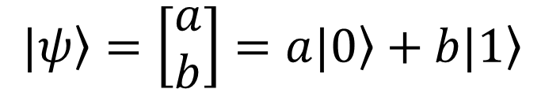
In a single qubit circuit, the state vector is a 2-element column vector containing complex numbers. Each complex number is an amplitude
Certain superposed states have special names:
Example:
$$\left.|0\right\rangle =\left[\begin{matrix}1 \\ 0\end{matrix}\right]$$
$$\left.|1\right\rangle =\left[\begin{matrix}0 \\ 1\end{matrix}\right]$$
$$\left.|ψ\right\rangle =\left[\begin{matrix}a \\ b\end{matrix}\right]=a\left.|0\right\rangle +b\left.|1\right\rangle$$
$$|\left.+\right\rangle =\frac{1}{\sqrt{2}}\left[\begin{matrix}1 \\ 1\end{matrix}\right]$$
$$|\left.−\right\rangle =\frac{1}{\sqrt{2}}\left[\begin{matrix}1 \\ −1\end{matrix}\right]$$
$$|\left.i\right\rangle =\frac{1}{\sqrt{2}}\left[\begin{matrix}1 \\ i\end{matrix}\right]$$
$$|\left.−i\right\rangle =\frac{1}{\sqrt{2}}\left[\begin{matrix}1 \\ −i\end{matrix}\right]$$
amplitudes
state vector
$$H\left.|0\right\rangle =\frac{1}{\sqrt{2}}\left[\begin{matrix}1 & 1 \\ 1 & −1\end{matrix}\right]\left[\begin{matrix}1 \\ 0\end{matrix}\right]=|\left.+\right\rangle$$
$$\left.|ψ\right\rangle =\left[\begin{matrix}a \\ b\end{matrix}\right]=a\left.|0\right\rangle +b\left.|1\right\rangle$$
base state vectors

Slide 22
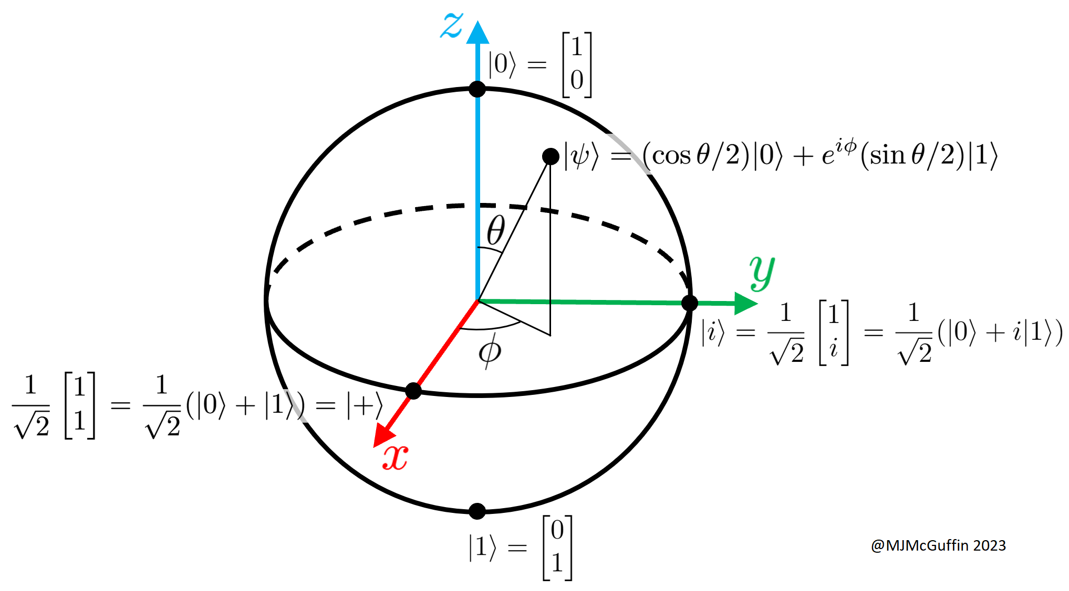
Bloch sphere: to visualize one qubit
We apply a global phase shift to obtain the form |ψ> = cos(θ/2) |0> + e^{i φ} sin(θ/2) |1>
which has two degrees of freedom, θ and φ, mapped to a surface. The vertical position of the point (encoded with θ) corresponds directly to the probability of measuring 0 or 1. φ is the relative phase, and is only meaningful and measurable if there are other qubits.
All quantum gates acting on 1 qubit are rotations in this space!

Slide 23
The processing of qubits can be described with matrix multiplications
output
amplitude for 0
amplitude for 0
amplitude for 1
amplitude for 1
$$\left[\begin{matrix}−0.707i \\ 0.707i\end{matrix}\right]=\left[\begin{matrix}1 & 0 \\ 0 & −1\end{matrix}\right]\left[\begin{matrix}0.707 & 0.707 \\ 0.707 & −0.707\end{matrix}\right]\left[\begin{matrix}0 & −i \\ i & 0\end{matrix}\right]\left[\begin{matrix}0 & 1 \\ 1 & 0\end{matrix}\right]\left[\begin{matrix}1 \\ 0\end{matrix}\right]$$
output state vector (this can be rewritten as |-> using a global phase shift)
input state vector

Slide 24
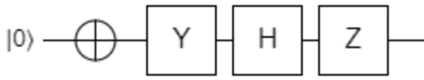
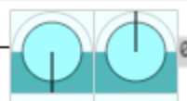
// qubit q0 |0>---(+)---(y)---hadamard---(z)---
//
input = CMatrix.ketZero /*q0*/;
step1 = CMatrix.gate2x2not;
step2 = CMatrix.gate2x2y;
step3 = CMatrix.gate2x2hadamard;
step4 = CMatrix.gate2x2z;
output = CMatrix.naryMult([ step4, step3, step2, step1, input ]);
console.log(StringUtil.concatenateMultilineStrings(
step4.toString(),
" * ", step3.toString(),
" * ", step2.toString(),
" * ", step1.toString(),
" * ", input.toString(),
" = ", output.toString({binaryPrefixes:true})
));
Code using classes defined at https://github.com/MJMcGuffin/muqcs.js
[1,0 ] * [0.707,0.707 ] * [0 ,-1i] * [_,1] * [1] = |0>[-0.707i]
[0,-1] [0.707,-0.707] [1i,0 ] [1,_] [_] |1>[0.707i ]
My code’s output
Simulation with Quirk
Notes:
https://algassert.com/quirk#circuit={%22cols%22:[[%22X%22],[%22Y%22],[%22H%22],[%22Z%22]]}
// qubit q0 |0>---(+)---(y)---hadamard---(z)---
//
input = CMatrix.ketZero /*q0*/;
step1 = CMatrix.gate2x2not;
step2 = CMatrix.gate2x2y;
step3 = CMatrix.gate2x2hadamard;
step4 = CMatrix.gate2x2z;
output = CMatrix.naryMult([ step4, step3, step2, step1, input ]);
console.log(StringUtil.concatenateMultilineStrings(
step4.toString(),
" * ",
step3.toString(),
" * ",
step2.toString(),
" * ",
step1.toString(),
" * ",
input.toString(),
" = ",
output.toString({binaryPrefixes:true})
));

Slide 25
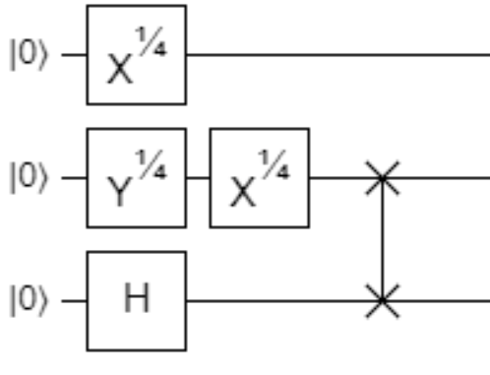
The processing of qubits can be described with matrix multiplications
output
8 amplitudes for states 000, 001, 010, 011, …, 111
8×8 matrix
8×8 matrix
8×8 matrix
=
×
×
×
8×1 output state vector
8×1 input state vector

Slide 26
Each 8×8 matrix is a tensor product (or kronecker product) of smaller matrices
(SWAP)⊗(I)
(I)⊗(X^{1/4})⊗(I)
(H)⊗(Y^{1/4})⊗(X^{1/4})
8 amplitudes for states 000, 001, 010, 011, …, 111
8×8 matrix
8×8 matrix
8×8 matrix
=
×
×
×
8×1 output state vector
8×1 input state vector

Slide 27
Each 8×8 matrix is a tensor product (or kronecker product) of smaller matrices
4×4
2×2
2×2
2×2
2×2
2×2
2×2
2×2
(SWAP)⊗(I)
(I)⊗(X^{1/4})⊗(I)
(H)⊗(Y^{1/4})⊗(X^{1/4})
8 amplitudes for states 000, 001, 010, 011, …, 111
8×8 matrix
8×8 matrix
8×8 matrix
=
×
×
×
8×1 output state vector
8×1 input state vector

Slide 28
Tensor product or kronecker product
a w | a x | b w | b x
a y | a z | b y | b z
c w | c x | d w | d x
c y | c z | d y | d z
a | b
c | d
w | x
y | z
⊗
=
We stretch the first matrix and make many copies of the second matrix, and multiply pairs of elements
The tensor product is associative but not commutative

Slide 29
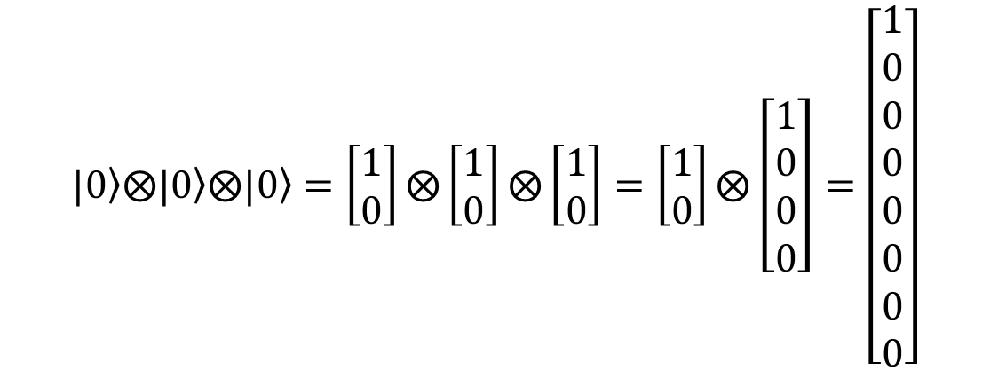
Example: the 8×1 input state vector for this circuit is a tensor product
$$\left.|0\right\rangle ⨂\left.|0\right\rangle ⨂\left.|0\right\rangle =\left[\begin{matrix}1 \\ 0\end{matrix}\right]⨂\left[\begin{matrix}1 \\ 0\end{matrix}\right]⨂\left[\begin{matrix}1 \\ 0\end{matrix}\right]=\left[\begin{matrix}1 \\ 0\end{matrix}\right]⨂\left[\begin{matrix}1 \\ 0 \\ 0 \\ 0\end{matrix}\right]=\left[\begin{matrix}1 \\ 0 \\ 0 \\ 0 \\ 0 \\ 0 \\ 0 \\ 0\end{matrix}\right]$$
8 amplitudes for states 000, 001, 010, 011, …, 111

Slide 30
The size of the matrices grows exponentially in the number N of qubits
2^{N}×2^{N} matrix
2^{N}×2^{N} matrix
=
× … ×
×
2^{N}×1 output state vector
2^{N}×1 input state vector
Generating and storing each matrix costs O((2^{N})²)=O(2^{2N}) space.
Multiplying two 2^{N}×2^{N} matrices using a naïve algorithm costs O((2^{N})³) time.
First optimization: we don’t actually need to multiply these large matrices together, because we can just multiply from right to left, updating the 2^{N}×1 state vector with each step. (Implemented in my code in CMatrix.naryMult().) So each step will only take O(2^{2N}) time instead of O(2^{3N}).

Slide 31
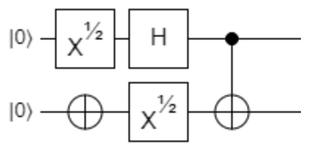
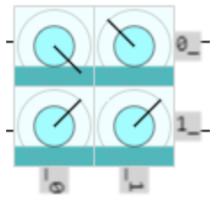
// qubit q0 |0>---(x^0.5)--hadamard----o-----
// |
// qubit q1 |0>-----(+)-----(x^0.5)---(+)----
//
input = CMatrix.tensor( CMatrix.ketZero /*q1*/, CMatrix.ketZero /*q0*/ );
step1 = CMatrix.tensor( CMatrix.gate2x2not /*q1*/, CMatrix.gate2x2rootx /*q0*/ );
step2 = CMatrix.tensor( CMatrix.gate2x2rootx /*q1*/, CMatrix.gate2x2hadamard /*q0*/ );
step3 = CMatrix.gate4x4cnot;
output = CMatrix.naryMult([ step3, step2, step1, input ]);
console.log(StringUtil.concatenateMultilineStrings(
step3.toString(),
" * ", step2.toString({decimalPrecision:2}),
" * ", step1.toString(),
" * ", input.toString(),
" = ", output.toString({binaryPrefixes:true})
));
First optimization implemented in this, which multiplies smaller matrices first before bigger ones.
[1,_,_,_] [0.35+0.35i,0.35+0.35i ,0.35-0.35i,0.35-0.35i ] [0 ,0 ,0.5+0.5i,0.5-0.5i] [1] |00>[0.354-0.354i ]
[_,_,_,1] * [0.35+0.35i,-0.35-0.35i,0.35-0.35i,-0.35+0.35i] * [0 ,0 ,0.5-0.5i,0.5+0.5i] * [_] = |01>[-0.354+0.354i]
[_,_,1,_] [0.35-0.35i,0.35-0.35i ,0.35+0.35i,0.35+0.35i ] [0.5+0.5i,0.5-0.5i,0 ,0 ] [_] |10>[0.354+0.354i ]
[_,1,_,_] [0.35-0.35i,-0.35+0.35i,0.35+0.35i,-0.35-0.35i] [0.5-0.5i,0.5+0.5i,0 ,0 ] [_] |11>[0.354+0.354i ]
My code’s output
Simulation
with Quirk
Notes:
// Simulate a circuit on two qubits equivalent to
// https://algassert.com/quirk#circuit={%22cols%22:[[%22X^%C2%BD%22,%22X%22],[%22H%22,%22X^%C2%BD%22],[%22%E2%80%A2%22,%22X%22]]}
//
// qubit q0 |0>---(x^0.5)--hadamard----o-----
// |
// qubit q1 |0>-----(+)-----(x^0.5)---(+)----
//
input = CMatrix.tensor( CMatrix.ketZero /*q1*/, CMatrix.ketZero /*q0*/ );
step1 = CMatrix.tensor( CMatrix.gate2x2not /*q1*/, CMatrix.gate2x2rootx /*q0*/ );
step2 = CMatrix.tensor( CMatrix.gate2x2rootx /*q1*/, CMatrix.gate2x2hadamard /*q0*/ );
step3 = CMatrix.gate4x4cnot;
output = CMatrix.naryMult([ step3, step2, step1, input ]);
console.log(StringUtil.concatenateMultilineStrings(
step3.toString(),
" * ",
step2.toString({decimalPrecision:2}),
" * ",
step1.toString(),
" * ",
input.toString(),
" = ",
output.toString({binaryPrefixes:true})
));

Slide 32
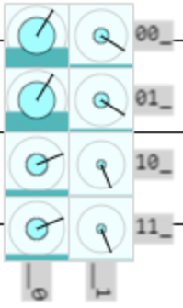
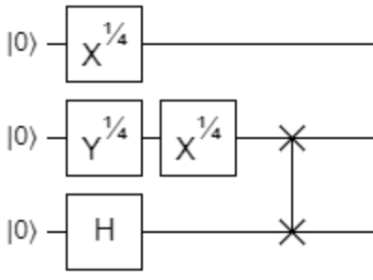
// qubit q0 |0>----(x^0.25)-----------------------
//
// qubit q1 |0>----(y^0.25)-----(x^0.25)----X-----
// |
// qubit q2 |0>-------H---------------------X-----
//
input = CMatrix.naryTensor( [ CMatrix.ketZero /*q2*/, CMatrix.ketZero /*q1*/, CMatrix.ketZero /*q0*/ ] );
step1 = CMatrix.naryTensor( [ CMatrix.gate2x2hadamard /*q2*/, CMatrix.gate2x2fourthrooty /*q1*/, CMatrix.gate2x2fourthrootx /*q0*/ ] );
step2 = CMatrix.naryTensor( [ CMatrix.gate2x2identity /*q2*/, CMatrix.gate2x2fourthrootx /*q1*/, CMatrix.gate2x2identity /*q0*/ ] );
step3 = CMatrix.wireSwap(1,2,3);
output = CMatrix.naryMult([ step3, step2, step1, input ]);
console.log(StringUtil.concatenateMultilineStrings(
step3.toString(),
" * ", step2.toString({decimalPrecision:1}),
" * ", "...", // step1.toString({decimalPrecision:1}),
" * ", input.toString(),
" = ", output.toString({binaryPrefixes:true})
));
[1,_,_,_,_,_,_,_] [0.9+0.4i,0 ,0.1-0.4i,0 ,0 ,0 ,0 ,0 ] [1] |000>[0.302+0.479i]
[_,1,_,_,_,_,_,_] [0 ,0.9+0.4i,0 ,0.1-0.4i,0 ,0 ,0 ,0 ] [_] |001>[0.198-0.125i]
[_,_,_,_,1,_,_,_] [0.1-0.4i,0 ,0.9+0.4i,0 ,0 ,0 ,0 ,0 ] [_] |010>[0.302+0.479i]
[_,_,_,_,_,1,_,_] * [0 ,0.1-0.4i,0 ,0.9+0.4i,0 ,0 ,0 ,0 ] * ... * [_] = |011>[0.198-0.125i]
[_,_,1,_,_,_,_,_] [0 ,0 ,0 ,0 ,0.9+0.4i,0 ,0.1-0.4i,0 ] [_] |100>[0.302+0.125i]
[_,_,_,1,_,_,_,_] [0 ,0 ,0 ,0 ,0 ,0.9+0.4i,0 ,0.1-0.4i] [_] |101>[0.052-0.125i]
[_,_,_,_,_,_,1,_] [0 ,0 ,0 ,0 ,0.1-0.4i,0 ,0.9+0.4i,0 ] [_] |110>[0.302+0.125i]
[_,_,_,_,_,_,_,1] [0 ,0 ,0 ,0 ,0 ,0.1-0.4i,0 ,0.9+0.4i] [_] |111>[0.052-0.125i]
My code’s output
Simulation
with Quirk
Notes:
// Simulate a circuit on three qubits equivalent to
// https://algassert.com/quirk#circuit={%22cols%22:[[%22X^%C2%BC%22,%22Y^%C2%BC%22,%22H%22],[1,%22X^%C2%BC%22],[1,%22Swap%22,%22Swap%22]]}
//
// qubit q0 |0>----(x^0.25)-----------------------
//
// qubit q1 |0>----(y^0.25)-----(x^0.25)----X-----
// |
// qubit q2 |0>-------H---------------------X-----
//
input = CMatrix.naryTensor( [ CMatrix.ketZero /*q2*/, CMatrix.ketZero /*q1*/, CMatrix.ketZero /*q0*/ ] );
step1 = CMatrix.naryTensor( [ CMatrix.gate2x2hadamard /*q2*/, CMatrix.gate2x2fourthrooty /*q1*/, CMatrix.gate2x2fourthrootx /*q0*/ ] );
step2 = CMatrix.naryTensor( [ CMatrix.gate2x2identity /*q2*/, CMatrix.gate2x2fourthrootx /*q1*/, CMatrix.gate2x2identity /*q0*/ ] );
step3 = CMatrix.wireSwap(1,2,3);
output = CMatrix.naryMult([ step3, step2, step1, input ]);
console.log(StringUtil.concatenateMultilineStrings(
step3.toString(),
" * ",
step2.toString({decimalPrecision:1}),
" * ",
"...", // step1.toString({decimalPrecision:1}),
" * ",
input.toString(),
" = ",
output.toString({binaryPrefixes:true})
));

Slide 33
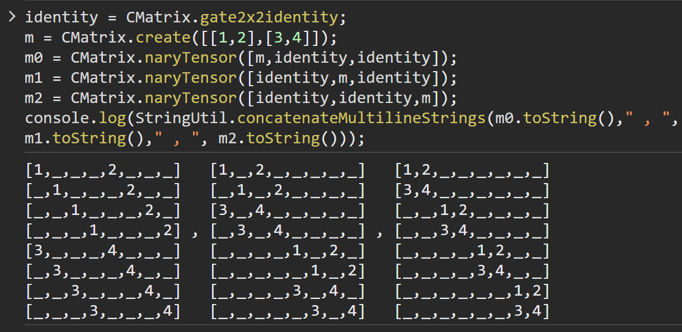
The tensor products are sparse (mostly contain zeros)
(m)⊗(I)⊗(I)
(I)⊗(m)⊗(I)
(I)⊗(I)⊗(m)
Second optimization: we don’t even need to store the matrices! There is a simple algorithm that iterates over all the non-zero entries, without storing a large matrix explicitly. In my code, see CMatrix. transformStateVectorWith2x2(), which is based on Quirk’s source code https://github.com/Strilanc/Quirk/ , src/math/Matrix.js , applyToStateVectorAtQubitWithControls()
Notes:
identity = CMatrix.gate2x2identity;
m = CMatrix.create([[1,2],[3,4]]);
m0 = CMatrix.naryTensor([m,identity,identity]);
m1 = CMatrix.naryTensor([identity,m,identity]);
m2 = CMatrix.naryTensor([identity,identity,m]);
console.log(StringUtil.concatenateMultilineStrings(m0.toString()," , ", m1.toString()," , ", m2.toString()));

Slide 34
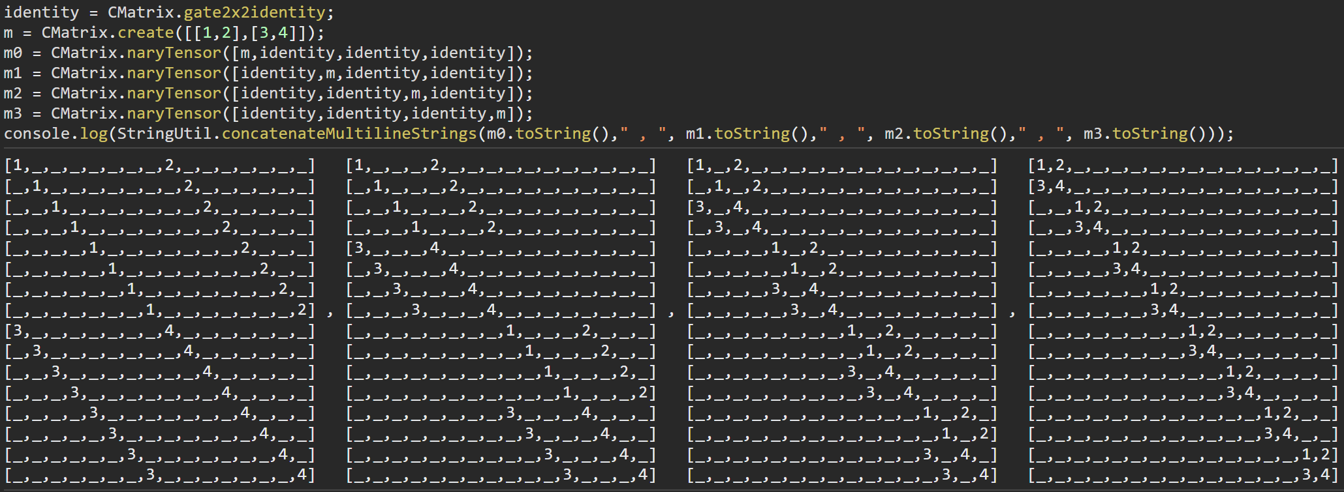
The tensor products are sparse (mostly contain zeros)
m⊗I⊗I⊗I
I⊗m⊗I⊗I
I⊗I⊗m⊗I
I⊗I⊗I⊗m
Second optimization: we don’t even need to store the matrices! There is a simple algorithm that iterates over all the non-zero entries, without storing a large matrix explicitly. In my code, see CMatrix. transformStateVectorWith2x2(), which is based on Quirk’s source code https://github.com/Strilanc/Quirk/ , src/math/Matrix.js , applyToStateVectorAtQubitWithControls()
Notes:
identity = CMatrix.gate2x2identity;
m = CMatrix.create([[1,2],[3,4]]);
m0 = CMatrix.naryTensor([m,identity,identity,identity]);
m1 = CMatrix.naryTensor([identity,m,identity,identity]);
m2 = CMatrix.naryTensor([identity,identity,m,identity]);
m3 = CMatrix.naryTensor([identity,identity,identity,m]);
console.log(StringUtil.concatenateMultilineStrings(m0.toString()," , ", m1.toString()," , ", m2.toString()," , ", m3.toString()));

Slide 35
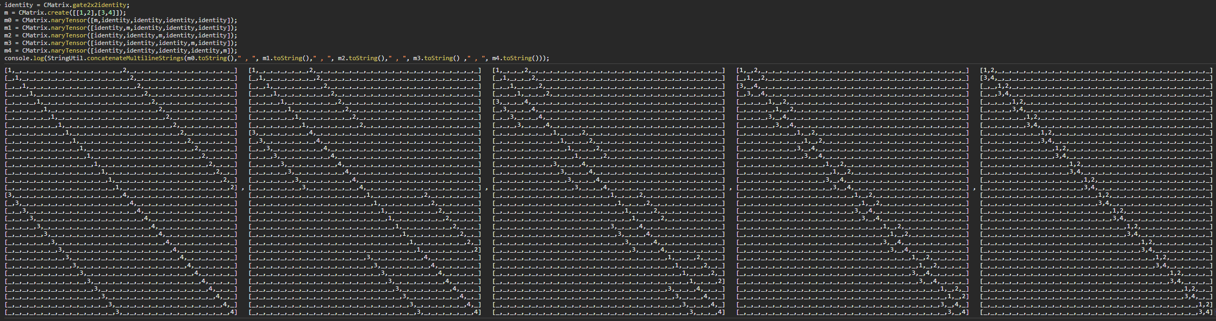
The tensor products are sparse (mostly contain zeros)
m⊗I⊗I⊗I⊗I
I⊗m⊗I⊗I⊗I
I⊗I⊗m⊗I⊗I
I⊗I⊗I⊗m⊗I
I⊗I⊗ I⊗I⊗m
Second optimization: we don’t even need to store the matrices! There is a simple algorithm that iterates over all the non-zero entries, without storing a large matrix explicitly. In my code, see CMatrix. transformStateVectorWith2x2(), which is based on Quirk’s source code https://github.com/Strilanc/Quirk/ , src/math/Matrix.js , applyToStateVectorAtQubitWithControls()
Notes:
identity = CMatrix.gate2x2identity;
m = CMatrix.create([[1,2],[3,4]]);
m0 = CMatrix.naryTensor([m,identity,identity,identity,identity]);
m1 = CMatrix.naryTensor([identity,m,identity,identity,identity]);
m2 = CMatrix.naryTensor([identity,identity,m,identity,identity]);
m3 = CMatrix.naryTensor([identity,identity,identity,m,identity]);
m4 = CMatrix.naryTensor([identity,identity,identity,identity,m]);
console.log(StringUtil.concatenateMultilineStrings(m0.toString()," , ", m1.toString()," , ", m2.toString()," , ", m3.toString() ," , ", m4.toString()));

Slide 36
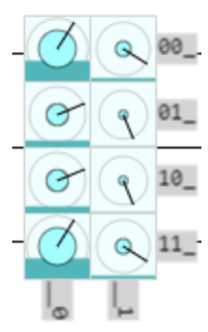
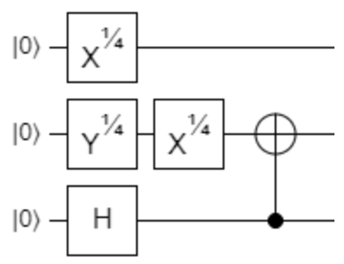
// qubit q0 |0>----(x^0.25)-------------------------
//
// qubit q1 |0>----(y^0.25)-----(x^0.25)----(+)-----
// |
// qubit q2 |0>-------H----------------------o------
//
input = CMatrix.naryTensor( [ CMatrix.ketZero /*q2*/, CMatrix.ketZero /*q1*/, CMatrix.ketZero /*q0*/ ] );
step1 = CMatrix.naryTensor( [ CMatrix.gate2x2hadamard /*q2*/, CMatrix.gate2x2fourthrooty /*q1*/, CMatrix.gate2x2fourthrootx /*q0*/ ] );
step2 = CMatrix.naryTensor( [ CMatrix.gate2x2identity /*q2*/, CMatrix.gate2x2fourthrootx /*q1*/, CMatrix.gate2x2identity /*q0*/ ] );
step3 = CMatrix.expand4x4ForNWires( CMatrix.gate4x4cnot, 2, 1, 3 );
output = CMatrix.naryMult([ step3, step2, step1, input ]);
console.log(StringUtil.concatenateMultilineStrings(
step3.toString(),
" * ", step2.toString({decimalPrecision:1}),
" * ", "...", // step1.toString({decimalPrecision:1}),
" * ", input.toString(),
" = ", output.toString({binaryPrefixes:true})
));
My code, without the second optimization
[1,_,_,_,_,_,_,_] [0.9+0.4i,0 ,0.1-0.4i,0 ,0 ,0 ,0 ,0 ] [1] |000>[0.302+0.479i]
[_,1,_,_,_,_,_,_] [0 ,0.9+0.4i,0 ,0.1-0.4i,0 ,0 ,0 ,0 ] [_] |001>[0.198-0.125i]
[_,_,1,_,_,_,_,_] [0.1-0.4i,0 ,0.9+0.4i,0 ,0 ,0 ,0 ,0 ] [_] |010>[0.302+0.125i]
[_,_,_,1,_,_,_,_] * [0 ,0.1-0.4i,0 ,0.9+0.4i,0 ,0 ,0 ,0 ] * ... * [_] = |011>[0.052-0.125i]
[_,_,_,_,_,_,1,_] [0 ,0 ,0 ,0 ,0.9+0.4i,0 ,0.1-0.4i,0 ] [_] |100>[0.302+0.125i]
[_,_,_,_,_,_,_,1] [0 ,0 ,0 ,0 ,0 ,0.9+0.4i,0 ,0.1-0.4i] [_] |101>[0.052-0.125i]
[_,_,_,_,1,_,_,_] [0 ,0 ,0 ,0 ,0.1-0.4i,0 ,0.9+0.4i,0 ] [_] |110>[0.302+0.479i]
[_,_,_,_,_,1,_,_] [0 ,0 ,0 ,0 ,0 ,0.1-0.4i,0 ,0.9+0.4i] [_] |111>[0.198-0.125i]
My code’s output
Simulation with Quirk
Notes:
// Simulate a circuit on three qubits equivalent to
// https://algassert.com/quirk#circuit={%22cols%22:[[%22X^%C2%BC%22,%22Y^%C2%BC%22,%22H%22],[1,%22X^%C2%BC%22],[1,%22X%22,%22%E2%80%A2%22]]}
//
// qubit q0 |0>----(x^0.25)-------------------------
//
// qubit q1 |0>----(y^0.25)-----(x^0.25)----(+)-----
// |
// qubit q2 |0>-------H----------------------o------
//
input = CMatrix.naryTensor( [ CMatrix.ketZero /*q2*/, CMatrix.ketZero /*q1*/, CMatrix.ketZero /*q0*/ ] );
step1 = CMatrix.naryTensor( [ CMatrix.gate2x2hadamard /*q2*/, CMatrix.gate2x2fourthrooty /*q1*/, CMatrix.gate2x2fourthrootx /*q0*/ ] );
step2 = CMatrix.naryTensor( [ CMatrix.gate2x2identity /*q2*/, CMatrix.gate2x2fourthrootx /*q1*/, CMatrix.gate2x2identity /*q0*/ ] );
step3 = CMatrix.expand4x4ForNWires( CMatrix.gate4x4cnot, 2, 1, 3 );
output = CMatrix.naryMult([ step3, step2, step1, input ]);
console.log(StringUtil.concatenateMultilineStrings(
step3.toString(),
" * ",
step2.toString({decimalPrecision:1}),
" * ",
"...", // step1.toString({decimalPrecision:1}),
" * ",
input.toString(),
" = ",
output.toString({binaryPrefixes:true})
));

Slide 37
// qubit q0 |0>----(x^0.25)-------------------------
//
// qubit q1 |0>----(y^0.25)-----(x^0.25)----(+)-----
// |
// qubit q2 |0>-------H----------------------o------
//
input = CMatrix.naryTensor( [ CMatrix.ketZero /*q2*/, CMatrix.ketZero /*q1*/, CMatrix.ketZero /*q0*/ ] );
step1 = CMatrix.transformStateVectorWith2x2(CMatrix.gate2x2hadamard,2,3,input,[]);
step1 = CMatrix.transformStateVectorWith2x2(CMatrix.gate2x2fourthrooty,1,3,step1,[]);
step1 = CMatrix.transformStateVectorWith2x2(CMatrix.gate2x2fourthrootx,0,3,step1,[]);
step2 = CMatrix.transformStateVectorWith2x2(CMatrix.gate2x2fourthrootx,1,3,step1,[]);
output = CMatrix.transformStateVectorWith2x2(CMatrix.gate2x2not,1,3,step2,[[2,true]]);
console.log(StringUtil.concatenateMultilineStrings(
input.toString(),
" -> ", step1.toString(),
" -> ", step2.toString(),
" -> ", output.toString({binaryPrefixes:true})
));
My code, with the second optimization
[1] [0.427+0.427i] [0.302+0.479i] |000>[0.302+0.479i]
[_] [0.177-0.177i] [0.198-0.125i] |001>[0.198-0.125i]
[_] [0.177+0.177i] [0.302+0.125i] |010>[0.302+0.125i]
[_] -> [0.073-0.073i] -> [0.052-0.125i] -> |011>[0.052-0.125i]
[_] [0.427+0.427i] [0.302+0.479i] |100>[0.302+0.125i]
[_] [0.177-0.177i] [0.198-0.125i] |101>[0.052-0.125i]
[_] [0.177+0.177i] [0.302+0.125i] |110>[0.302+0.479i]
[_] [0.073-0.073i] [0.052-0.125i] |111>[0.198-0.125i]
Simulation with Quirk
My code’s output
Notes:
// Simulate the same circuit, but this time without using explicit large matrices.
//
// qubit q0 |0>----(x^0.25)-------------------------
//
// qubit q1 |0>----(y^0.25)-----(x^0.25)----(+)-----
// |
// qubit q2 |0>-------H----------------------o------
//
input = CMatrix.naryTensor( [ CMatrix.ketZero /*q2*/, CMatrix.ketZero /*q1*/, CMatrix.ketZero /*q0*/ ] );
step1 = CMatrix.transformStateVectorWith2x2(CMatrix.gate2x2hadamard,2,3,input,[]);
step1 = CMatrix.transformStateVectorWith2x2(CMatrix.gate2x2fourthrooty,1,3,step1,[]);
step1 = CMatrix.transformStateVectorWith2x2(CMatrix.gate2x2fourthrootx,0,3,step1,[]);
step2 = CMatrix.transformStateVectorWith2x2(CMatrix.gate2x2fourthrootx,1,3,step1,[]);
output = CMatrix.transformStateVectorWith2x2(CMatrix.gate2x2not,1,3,step2,[[2,true]]);
console.log(StringUtil.concatenateMultilineStrings(
input.toString(),
" -> ", step1.toString(),
" -> ", step2.toString(),
" -> ", output.toString({binaryPrefixes:true})
));

Slide 38
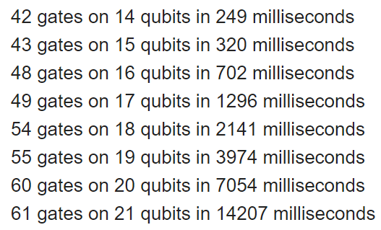
Without the second optimization, we store explicit 2^{N}×2^{N} matrices, and at N=13 qubits, each matrix takes 0.5 gigabytes (assuming 32 bit precision)
With the second optimization, by not storing explicit matrices, we can scale up to 20+ qubits
Runtimes on a 2018 laptop, running JavaScript code inside Chrome, without using the GPU for anything:

Slide 39

For more advanced simulation algorithms, check: Viamontes, Markov, Hayes (2009) "Quantum Circuit Simulation"

Slide 40
Example software
IBM Quantum Composer
https://quantum-computing.ibm.com/composer

Slide 41

IBM Quantum Lab / IBM Quantum Composer

Slide 42

IBM Quantum Lab / IBM Quantum Composer

Slide 43

IBM Quantum Lab / IBM Quantum Composer

Slide 44


IBM Quantum Lab / IBM Quantum Composer

Slide 45

IBM Quantum Lab / IBM Quantum Composer

Slide 46

IBM Quantum Lab / IBM Quantum Composer

Slide 47

IBM Quantum Lab / IBM Quantum Composer

Slide 48

IBM Quantum Lab / IBM Quantum Composer

Slide 49



Phase disk

Slide 50
Example software
IBM Quantum Composer
https://quantum-computing.ibm.com/composer
Quirk
https://algassert.com/quirk

Slide 51

Quirk

Slide 52
A more complicated circuit example …

Slide 53






… in IBM Quantum Composer: https://quantum-computing.ibm.com/composer
Copy-paste this into IBM’s website to recreate the circuit:
OPENQASM 2.0;
include "qelib1.inc";
qreg q[4];
rx(pi / 2) q[1];
rx(pi / 2) q[2];
rx(pi/4) q[0];
ry(pi/4) q[3];
rz(1.7453292519943295) q[1];
rz(2.0943951023931953) q[2];
rx(pi/4) q[3];
crz(pi / 2) q[1], q[2];
cry(pi/4) q[3], q[2];
[ -0.198-0.347j, -0.144+0.082j, -0.362-0.171j, -0.071+0.15j, 0.002-0.4j, -0.166-0.001j, 0.329-0.228j, -0.094-0.136j, -0.143-0.018j, -0.007+0.059j, -0.24+0.12j, 0.05+0.1j, -0.203-0.212j, -0.088+0.084j, -0.014-0.185j, -0.077+0.006j ]

Slide 54
… in IBM Quantum Composer: https://quantum-computing.ibm.com/composer
Copy-paste this into IBM’s website to recreate the circuit:
OPENQASM 2.0;
include "qelib1.inc";
qreg q[4];
rx(pi / 2) q[1];
rx(pi / 2) q[2];
rx(pi/4) q[0];
ry(pi/4) q[3];
rz(1.7453292519943295) q[1];
rz(2.0943951023931953) q[2];
rx(pi/4) q[3];
crz(pi / 2) q[1], q[2];
cry(pi/4) q[3], q[2];
ph
am
bp
pr
Legend:
am amplitudes
bp base state probabilities
ph phase
pr probabilities
pu purity
[ -0.198-0.347j, -0.144+0.082j, -0.362-0.171j, -0.071+0.15j, 0.002-0.4j, -0.166-0.001j, 0.329-0.228j, -0.094-0.136j, -0.143-0.018j, -0.007+0.059j, -0.24+0.12j, 0.05+0.1j, -0.203-0.212j, -0.088+0.084j, -0.014-0.185j, -0.077+0.006j ]
am
pu

Slide 55
Phase disk

Slide 56






… in Quirk: https://algassert.com/quirk#circuit={%22cols%22:[[{%22id%22:%22Rxft%22,%22arg%22:%22pi/4%22},{%22id%22:%22Rxft%22,%22arg%22:%22pi/2%22},{%22id%22:%22Rxft%22,%22arg%22:%22pi/2%22},{%22id%22:%22Ryft%22,%22arg%22:%22pi/4%22}],[1,{%22id%22:%22Rzft%22,%22arg%22:%221.7453292519943295%22},{%22id%22:%22Rzft%22,%22arg%22:%222.0943951023931953%22},{%22id%22:%22Rxft%22,%22arg%22:%22pi/4%22}],[],[],[],[1,%22%E2%80%A2%22,{%22id%22:%22Rzft%22,%22arg%22:%22pi/2%22}],[1,1,{%22id%22:%22Ryft%22,%22arg%22:%22pi/4%22},%22%E2%80%A2%22],[%22Chance4%22],[%22Density4%22],[],[],[],[%22Density%22,%22Density%22,%22Density%22,%22Density%22]]}

Slide 57
… in Quirk: https://algassert.com/quirk#circuit={%22cols%22:[[{%22id%22:%22Rxft%22,%22arg%22:%22pi/4%22},{%22id%22:%22Rxft%22,%22arg%22:%22pi/2%22},{%22id%22:%22Rxft%22,%22arg%22:%22pi/2%22},{%22id%22:%22Ryft%22,%22arg%22:%22pi/4%22}],[1,{%22id%22:%22Rzft%22,%22arg%22:%221.7453292519943295%22},{%22id%22:%22Rzft%22,%22arg%22:%222.0943951023931953%22},{%22id%22:%22Rxft%22,%22arg%22:%22pi/4%22}],[],[],[],[1,%22%E2%80%A2%22,{%22id%22:%22Rzft%22,%22arg%22:%22pi/2%22}],[1,1,{%22id%22:%22Ryft%22,%22arg%22:%22pi/4%22},%22%E2%80%A2%22],[%22Chance4%22],[%22Density4%22],[],[],[],[%22Density%22,%22Density%22,%22Density%22,%22Density%22]]}
Legend:
am amplitudes
bp base state probabilities
ph phase
pr probabilities
pu purity
dm density matrix
rdm reduced density matrices
co coordinates
sc spherical coordinates
bp
dm
rdm
pr
am
sc
co
ph

Slide 58
… in muqcs: https://mjmcguffin.github.io/muqcs.js/
let N = 4; // total qubits
input = CMatrix.naryTensor( [ CMatrix.ketZero /*q3*/, CMatrix.ketZero /*q2*/,
CMatrix.ketZero /*q1*/, CMatrix.ketZero /*q0*/ ] );
step1 = CMatrix.naryTensor( [ CMatrix.gate2x2ry(45) /*q3*/, CMatrix.gate2x2rx90degrees /*q2*/,
CMatrix.gate2x2rx90degrees /*q1*/, CMatrix.gate2x2rx(45) /*q0*/ ] );
step2 = CMatrix.naryTensor( [ CMatrix.gate2x2rx(45) /*q3*/, CMatrix.gate2x2rz(120) /*q2*/,
CMatrix.gate2x2rz(100) /*q1*/, CMatrix.gate2x2identity /*q0*/ ] );
output = CMatrix.naryMult([ step2, step1, input ]);
output = CMatrix.transformStateVectorWith2x2(CMatrix.gate2x2rz90degrees,2,N,output,[[1,true]]/*list of control qubits*/);
output = CMatrix.transformStateVectorWith2x2(CMatrix.gate2x2ry(45),2,N,output,[[3,true]]/*list of control qubits*/);
baseStateProbabilities = new CMatrix( output._rows, 1 );
for ( let i=0; i < output._rows; ++i ) baseStateProbabilities.set( i, 0, output.get(i,0).mag()**2 );
console.log(StringUtil.concatenateMultilineStrings(
"Output: ", output.toString({binaryPrefixes:true}), ", Probabilities: ", baseStateProbabilities.toString()
));
CMatrix.printAnalysisOfEachQubit(N,output);
|0000>[-0.198-0.347i] [0.160]
|0001>[-0.144+0.082i] [0.027]
|0010>[-0.362-0.171i] [0.160]
|0011>[-0.071+0.150i] [0.027]
|0100>[0.002-0.400i ] [0.160]
|0101>[-0.166-0.001i] [0.027]
|0110>[0.329-0.228i ] [0.160]
Output: |0111>[-0.094-0.136i], Probabilities: [0.027]
|1000>[-0.143-0.018i] [0.021]
|1001>[-0.007+0.059i] [0.004]
|1010>[-0.240+0.120i] [0.072]
|1011>[0.050+0.100i ] [0.012]
|1100>[-0.203-0.212i] [0.086]
|1101>[-0.088+0.084i] [0.015]
|1110>[-0.014-0.185i] [0.034]
|1111>[-0.077+0.006i] [0.006]
Legend:
am amplitudes
bp base state probabilities
ph phase
pr probabilities
pu purity
dm density matrix
rdm reduced density matrices
co coordinates
sc spherical coordinates
am
bp

Slide 59
… in muqcs: https://mjmcguffin.github.io/muqcs.js/
Legend:
am amplitudes
bp base state probabilities
ph phase
pr probabilities
pu purity
dm density matrix
rdm reduced density matrices
co coordinates
sc spherical coordinates
Density matrix is
[0.16 ,0.00+0.07i ,0.13+0.09i ,-0.04+0.05i,0.14-0.08i ,0.03+0.06i ,0.01-0.16i ,0.07+0.01i ,0.03+0.05i ,-0.02+0.01i,0.01+0.11i ,-0.04+0.00i,0.11+0.03i ,-0.01+0.05i,0.07-0.03i ,0.01+0.03i ]
[0.00-0.07i ,0.03 ,0.04-0.05i ,0.02+0.02i ,-0.03-0.06i,0.02-0.01i ,-0.07-0.01i,0.00-0.03i ,0.02-0.01i ,0.01+0.01i ,0.04-0.00i ,0.00+0.02i ,0.01-0.05i ,0.02+0.00i ,-0.01-0.03i,0.01-0.01i ]
[0.13-0.09i ,0.04+0.05i ,0.16 ,-0.00+0.07i,0.07-0.15i ,0.06+0.03i ,-0.08-0.14i,0.06-0.03i ,0.05+0.02i ,-0.01+0.02i,0.07+0.08i ,-0.03+0.03i,0.11-0.04i ,0.02+0.05i ,0.04-0.06i ,0.03+0.02i ]
[-0.04-0.05i,0.02-0.02i ,-0.00-0.07i,0.03 ,-0.06-0.03i,0.01-0.02i ,-0.06+0.03i,-0.01-0.02i,0.01-0.02i ,0.01+0.00i ,0.03-0.03i ,0.01+0.01i ,-0.02-0.05i,0.02-0.01i ,-0.03-0.02i,0.01-0.01i ]
[0.14+0.08i ,-0.03+0.06i,0.07+0.15i ,-0.06+0.03i,0.16 ,0.00+0.07i ,0.09-0.13i ,0.05+0.04i ,0.01+0.06i ,-0.02+0.00i,-0.05+0.10i,-0.04-0.02i,0.08+0.08i ,-0.03+0.03i,0.07+0.01i ,-0.00+0.03i]
[0.03-0.06i ,0.02+0.01i ,0.06-0.03i ,0.01+0.02i ,0.00-0.07i ,0.03 ,-0.05-0.04i,0.02-0.02i ,0.02-0.00i ,0.00+0.01i ,0.04+0.02i ,-0.01+0.02i,0.03-0.03i ,0.01+0.01i ,0.00-0.03i ,0.01+0.00i ]
[0.01+0.16i ,-0.07+0.01i,-0.08+0.14i,-0.06-0.03i,0.09+0.13i ,-0.05+0.04i,0.16 ,-0.00+0.07i,-0.04+0.04i,-0.02-0.02i,-0.11+0.02i,-0.01-0.04i,-0.02+0.12i,-0.05-0.01i,0.04+0.06i ,-0.03+0.02i]
[0.07-0.01i ,0.00+0.03i ,0.06+0.03i ,-0.01+0.02i,0.05-0.04i ,0.02+0.02i ,-0.00-0.07i,0.03 ,0.02+0.02i ,-0.01+0.01i,0.01+0.04i ,-0.02+0.00i,0.05+0.01i ,-0.00+0.02i,0.03-0.02i ,0.01+0.01i ]
[0.03-0.05i ,0.02+0.01i ,0.05-0.02i ,0.01+0.02i ,0.01-0.06i ,0.02+0.00i ,-0.04-0.04i,0.02-0.02i ,0.02 ,0.00+0.01i ,0.03+0.02i ,-0.01+0.01i,0.03-0.03i ,0.01+0.01i ,0.01-0.03i ,0.01+0.00i ]
[-0.02-0.01i,0.01-0.01i ,-0.01-0.02i,0.01-0.00i ,-0.02-0.00i,0.00-0.01i ,-0.02+0.02i,-0.01-0.01i,0.00-0.01i ,0.00 ,0.01-0.01i ,0.01+0.00i ,-0.01-0.01i,0.01-0.00i ,-0.01-0.00i,0.00-0.00i ]
[0.01-0.11i ,0.04+0.00i ,0.07-0.08i ,0.03+0.03i ,-0.05-0.10i,0.04-0.02i ,-0.11-0.02i,0.01-0.04i ,0.03-0.02i ,0.01+0.01i ,0.07 ,-0.00+0.03i,0.02-0.08i ,0.03+0.01i ,-0.02-0.05i,0.02-0.01i ]
[-0.04-0.00i,0.00-0.02i ,-0.03-0.03i,0.01-0.01i ,-0.04+0.02i,-0.01-0.02i,-0.01+0.04i,-0.02-0.00i,-0.01-0.01i,0.01-0.00i ,-0.00-0.03i,0.01 ,-0.03-0.01i,0.00-0.01i ,-0.02+0.01i,-0.00-0.01i]
[0.11-0.03i ,0.01+0.05i ,0.11+0.04i ,-0.02+0.05i,0.08-0.08i ,0.03+0.03i ,-0.02-0.12i,0.05-0.01i ,0.03+0.03i ,-0.01+0.01i,0.02+0.08i ,-0.03+0.01i,0.09 ,-0.00+0.04i,0.04-0.03i ,0.01+0.02i ]
[-0.01-0.05i,0.02-0.00i ,0.02-0.05i ,0.02+0.01i ,-0.03-0.03i,0.01-0.01i ,-0.05+0.01i,-0.00-0.02i,0.01-0.01i ,0.01+0.00i ,0.03-0.01i ,0.00+0.01i ,-0.00-0.04i,0.01 ,-0.01-0.02i,0.01-0.01i ]
[0.07+0.03i ,-0.01+0.03i,0.04+0.06i ,-0.03+0.02i,0.07-0.01i ,0.00+0.03i ,0.04-0.06i ,0.03+0.02i ,0.01+0.03i ,-0.01+0.00i,-0.02+0.05i,-0.02-0.01i,0.04+0.03i ,-0.01+0.02i,0.03 ,-0.00+0.01i]
[0.01-0.03i ,0.01+0.01i ,0.03-0.02i ,0.01+0.01i ,-0.00-0.03i,0.01-0.00i ,-0.03-0.02i,0.01-0.01i ,0.01-0.00i ,0.00+0.00i ,0.02+0.01i ,-0.00+0.01i,0.01-0.02i ,0.01+0.01i ,-0.00-0.01i,0.01 ]
with trace 1.000 and purity 1.000
dm
Reduced density matrix for qubit 0 is [0.854 ,-0.000+0.354i] with trace 1.000 and purity 1.000
[-0.000-0.354i,0.146 ]
Reduced density matrix for qubit 1 is [0.500 ,0.348-0.061i] with trace 1.000 and purity 0.750
[0.348+0.061i,0.500 ]
Reduced density matrix for qubit 2 is [0.484 ,0.085-0.342i] with trace 1.000 and purity 0.748
[0.085+0.342i,0.516 ]
Reduced density matrix for qubit 3 is [0.750 ,0.261+0.323i] with trace 1.000 and purity 0.971
[0.261-0.323i,0.250 ]
q0: (x=-0.000,y=-0.707,z=0.707) (r=1.000,phase=4.712rad=270.000deg,theta=0.785rad=45.000deg), probability(|1>)=0.146, purity=1.000, (0.924)|0>+(-0.000-0.383i)|1>
q1: (x=0.696,y=0.123,z=0.000) (r=0.707,phase=0.175rad=10.000deg,theta=1.571rad=90.000deg), probability(|1>)=0.500, purity=0.750, (0.707)|0>+(0.696+0.123i)|1>
q2: (x=0.170,y=0.683,z=-0.032) (r=0.705,phase=1.327rad=76.054deg,theta=1.617rad=92.632deg), probability(|1>)=0.516, purity=0.748, (0.691)|0>+(0.174+0.702i)|1>
q3: (x=0.523,y=-0.647,z=0.500) (r=0.970,phase=5.392rad=308.939deg,theta=1.029rad=58.981deg), probability(|1>)=0.250, purity=0.971, (0.870)|0>+(0.309-0.383i)|1>
rdm
ph
pr
pu
co
sc

Slide 60
Examples of proposed visualizations

Slide 61



Williams, Milan Marie 2021 QCVis: A Quantum Circuit Visualization and Education Platform for Novices Bachelor's thesis, Harvard College https://nrs.harvard.edu/URN-3:HUL.INSTREPOS:37368560 https://dash.harvard.edu/handle/1/37368560

Slide 62



% height is probability, color shows phase; it also makes it clearer when things are entangled (although this only works if the entanglement is limited to adjacent qubits) % "entangled states are represented by boxes that span across several columns, indicating which qubits are entangled. On the contrary, non-entangled (i.e. separable) states are represented by 1-column boxes." Jean-Baptiste Lamy Dynamic software visualization of quantum algorithms with rainbow boxes IVAPP 2019 2019 https://hal.archives-ouvertes.fr/hal-02264243/document

Slide 63

Lin, Siyuan, Jiang Hao, and Lingyun Sun. "Quflow: Visualizing parameter flow in quantum circuits for understanding quantum computation." In 2018 IEEE Scientific Visualization Conference (SciVis), pp. 37-41. IEEE, 2018.

Slide 64

Craig Gidney, 2017 https://algassert.com/post/1716

Slide 65


Slide 66


Slide 67


Slide 68
Resources
Book:
Michael Nielsen, Isaac Chuang, Quantum Computation and Quantum Information, 2010
Free books:
Thomas G. Wong, Introduction to Classical and Quantum Computing, 2022, http://www.thomaswong.net/
Venkateswaran Kasirajan, Fundamentals of Quantum Computing: Theory and Practice, 2021, https://link.springer.com/book/10.1007/978-3-030-63689-0?&utm_medium=display&utm_source=criteo&utm_campaign=3_fjp8312_product_us_springerlink&utm_content=us_banner_29012020
Ciaran Hughes, Joshua Isaacson, Anastasia Perry, Ranbel F. Sun, Jessica Turner, Quantum Computing for the Quantum Curious, 2021, https://library.oapen.org/bitstream/handle/20.500.12657/48236/9783030616014.pdf
Non-technical explanation of Shor’s algorithm:
https://scottaaronson.blog/?p=208
Playlist:
https://www.youtube.com/playlist?list=PLWDaTqG3UM0Ow0QWaxeeYTmr0hyF1duRl

